Slide 1




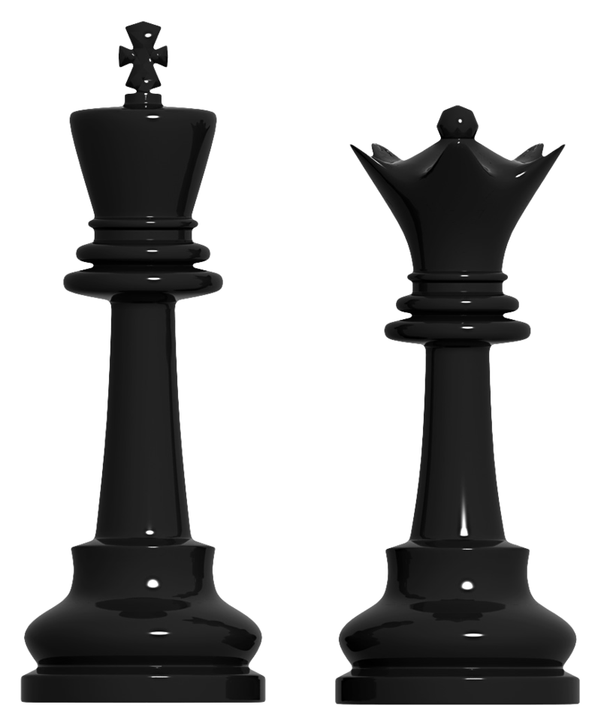


CIVIL ENGINEERING DEPARTMENT
SPRING 2025-2026
^{31st} CIVIL ENGINEERING WEEK PROGRAM
11 May – 2026 (MONDAY)
TIME | ACTIVITY | ACTIVITY INFORMATION |  | LOCATION
13:00 – 14:00 | TECHNICAL TALK-1 |  | Opening Speeches by - Chairperson Assoc. Prof. Dr. Eriş UYGAR | SEMINAR ROOM CE 105
 |  |  | -Prof. Dr. Serhan Şensoy
 |  |  | An engineered failure: ISIAS Hotel Collapse triggered by 2023 Kahramanmaraş Earthquake
14:00 – 15:00 | TABLE TENNIS TOURNAMENT |  | Group Stages | First Floor
14:30 – 16:00 | CHESS TOURNAMENT |  | Group Stages | Civil Engineering Drawing Room
16:30-17:30 | FOOTBALL TOURNAMENT |  | Group Stages: 16:30 | EMU SPORTS COMPLEX Football Field

Slide 2
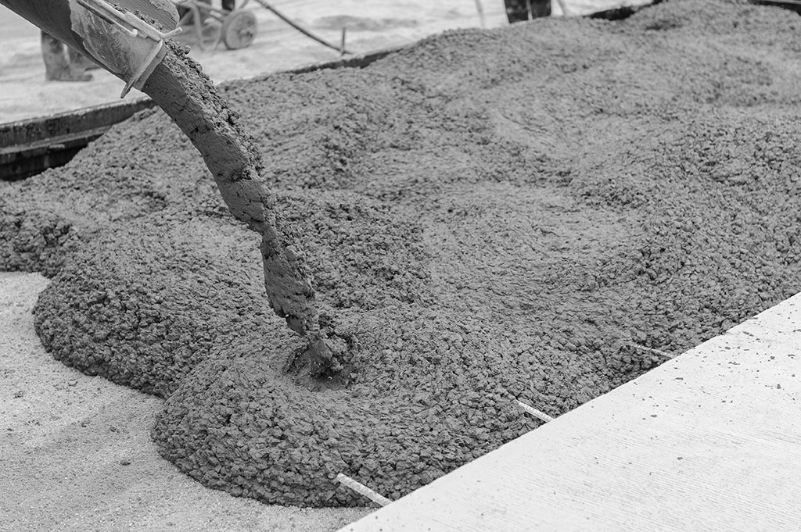





CIVIL ENGINEERING DEPARTMENT
SPRING 2025-2026
31st CIVIL ENGINEERING WEEK PROGRAM
12 May – 2026 (TUESDAY)
TIME | ACTIVITY | ACTIVITY INFORMATION |  | LOCATION
10:30 – 11:30 | TECHNICAL TALK-2 |  | -Prof. Dr. Bertuğ Akıntuğ Civil Engineering as a Profession: A different career path | SEMINAR ROOM CE 105
11:30 – 12:30 | Highest Strength Competition |  | Hishest concrete strength competıtıon | Departure from Civil Engineering Department Construction Lab
12:00 – 13:15 | CHESS TOURNAMENT |  | Semi Finals & Final | Civil Engineering Drawing Room
13:15-15:30 | FIELD TRIP |  | Çınarlı Village Incirli Cave | PARKING AREA
16:30-17:30 | FOOTBALL TOURNAMENT |  | Semi Finals & Final | EMU SPORTS COMPLEX Football Field
For further inquiries, visit
FOR FURTHER DETAILS OF ACTIVITIES PLEASE REFER TO POSTERS!
civil.emu.edu.tr/en
facebook.com/civil.emu.edu.tr/
@CIVILDEPT_EMU

Slide 3
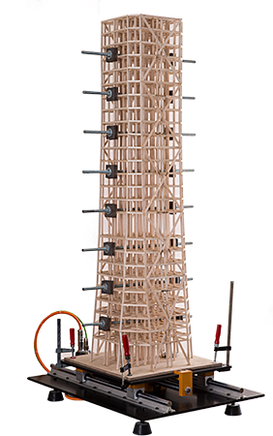

CIVIL ENGINEERING DEPARTMENT
SPRING 2025-2026
31st CIVIL ENGINEERING WEEK PROGRAM
13 May – 2026 (WEDNESDAY)
TIME | ACTIVITY | ACTIVITY INFORMATION |  | LOCATION
12:30 – 14:00 | Model Testing |  | EARTHQUAKE RESISTANCE MODEL COMPETITION | Ground Floor Beneath Seminar Room
14:00 – 14:30 | AWARDS CEREMONY |  | DISTRIBUTION OF MEDALS AND CERTIFICATES | Ground Floor Beneath Seminar Room
14:30 | COCKTAIL PARTY Seminar Room
For further inquiries, visit
FOR FURTHER DETAILS OF ACTIVITIES PLEASE REFER TO POSTERS!
civil.emu.edu.tr/en
facebook.com/civil.emu.edu.tr/
@CIVILDEPT_EMU

